Slide 1




Epsilon Stream and Exploding Dots
By Yousuf Marvi, 7th grade math, founding teacher at KIPP Comienza Upper School, East Los Angles, and Content Editor at One on Epsilon
@EpsilonMarvi @OneOnEpsilon

Slide 2
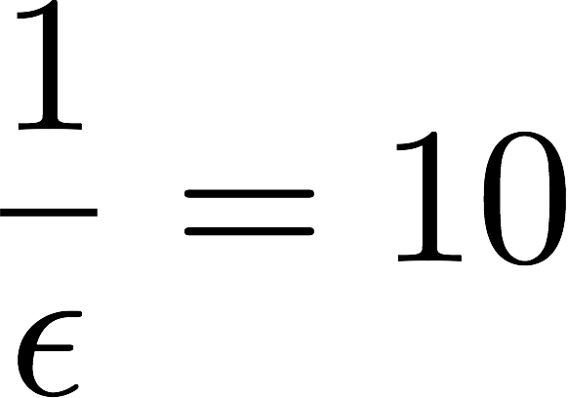


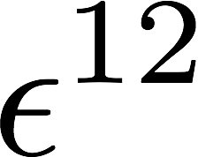

One on Epsilon
Nurturing, Mathematical Curiosity
What if we replace by ?

Slide 3
… with our 12, Parents, Teachers and Researchers…
Nurturing, Mathematical Curiosity
P
P
T
T
T
P,T,R
R
P,T,R
T,R
R
P

Slide 4
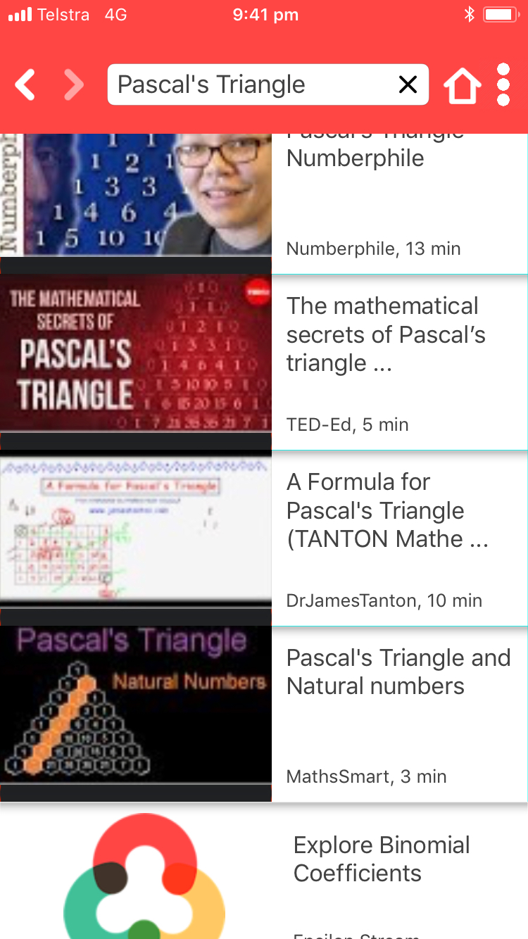
Epsilon Stream Watch, Play, and Explore Mathematics

Slide 5



Original content…
Curious Epsilon Blog Posts
Snippets describing math topics
Editors’ Picks Blog Posts

Slide 6







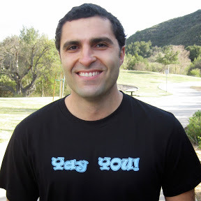

YouTube Mathematics
Over 100 solid channels
Around 50,000 videos
Estimate: 4.5 Million view hours/mo (English)
equivalent 5.5 Million people watching 12 min/wk
Notes:
Yay Math
Krista King
Khan Academy doesn’t include khan academy, vsauce,

Slide 7
Epsilon Stream Watch Play and Explore Mathematics
About 1000 search topics
About 2000 curated videos
Blog posts
Links to iOS Apps
Free
www.epsilonstream.com
Notes:
Our app isn’t a junkyard of every single math topic but rather very selected topics.

Slide 8
+
Linking to Exploding Dots…
Search Mathematics

Slide 9
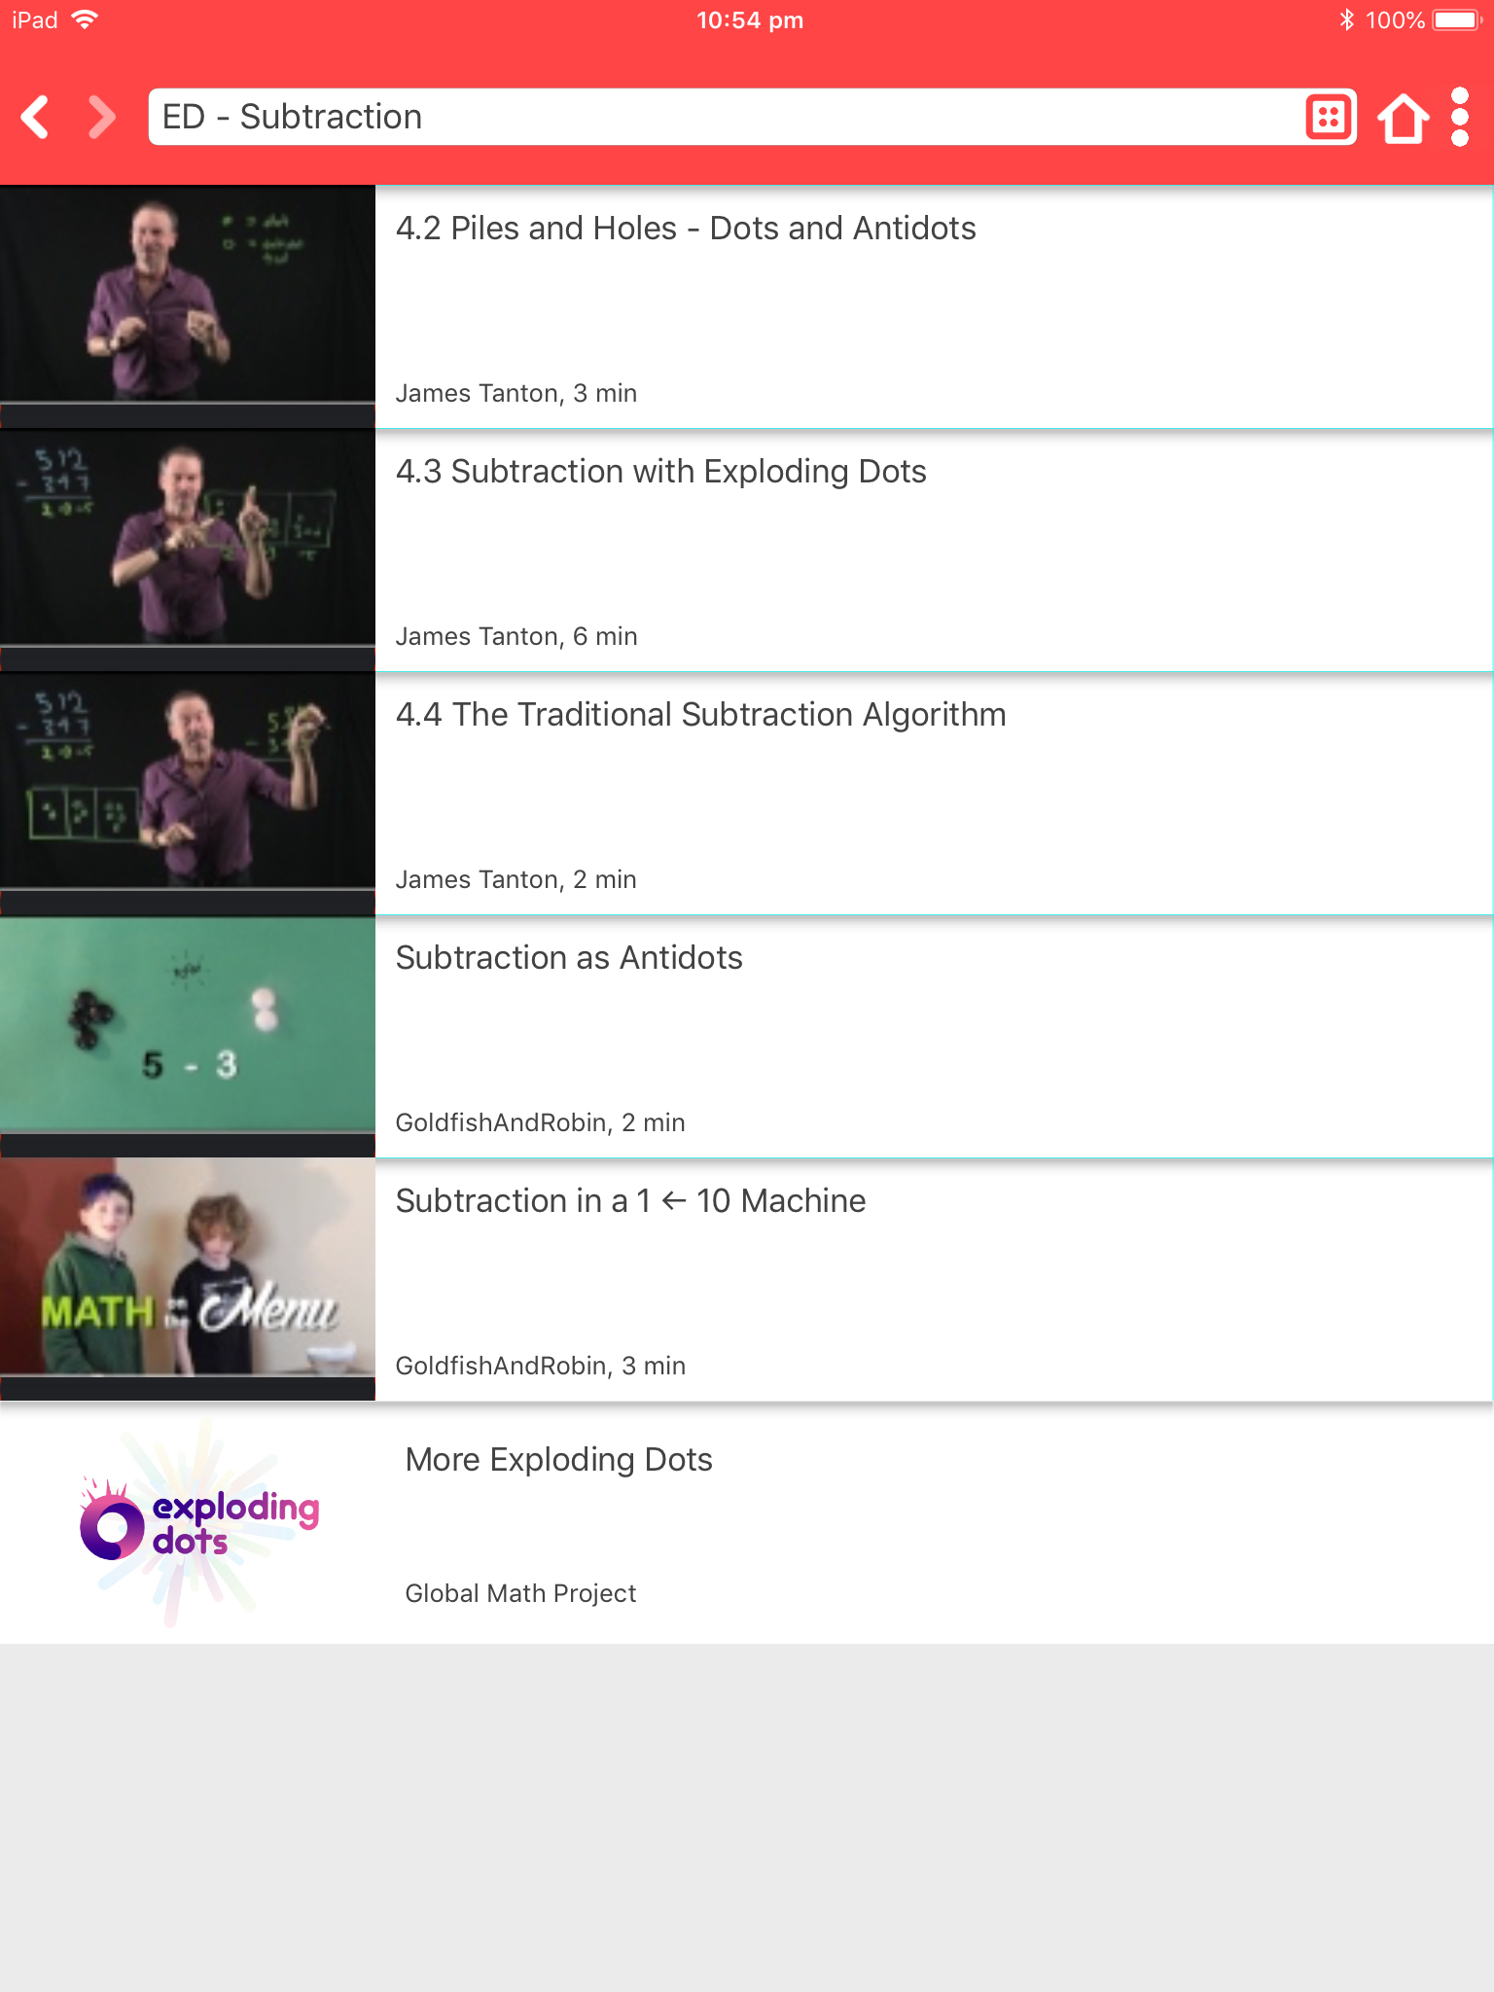
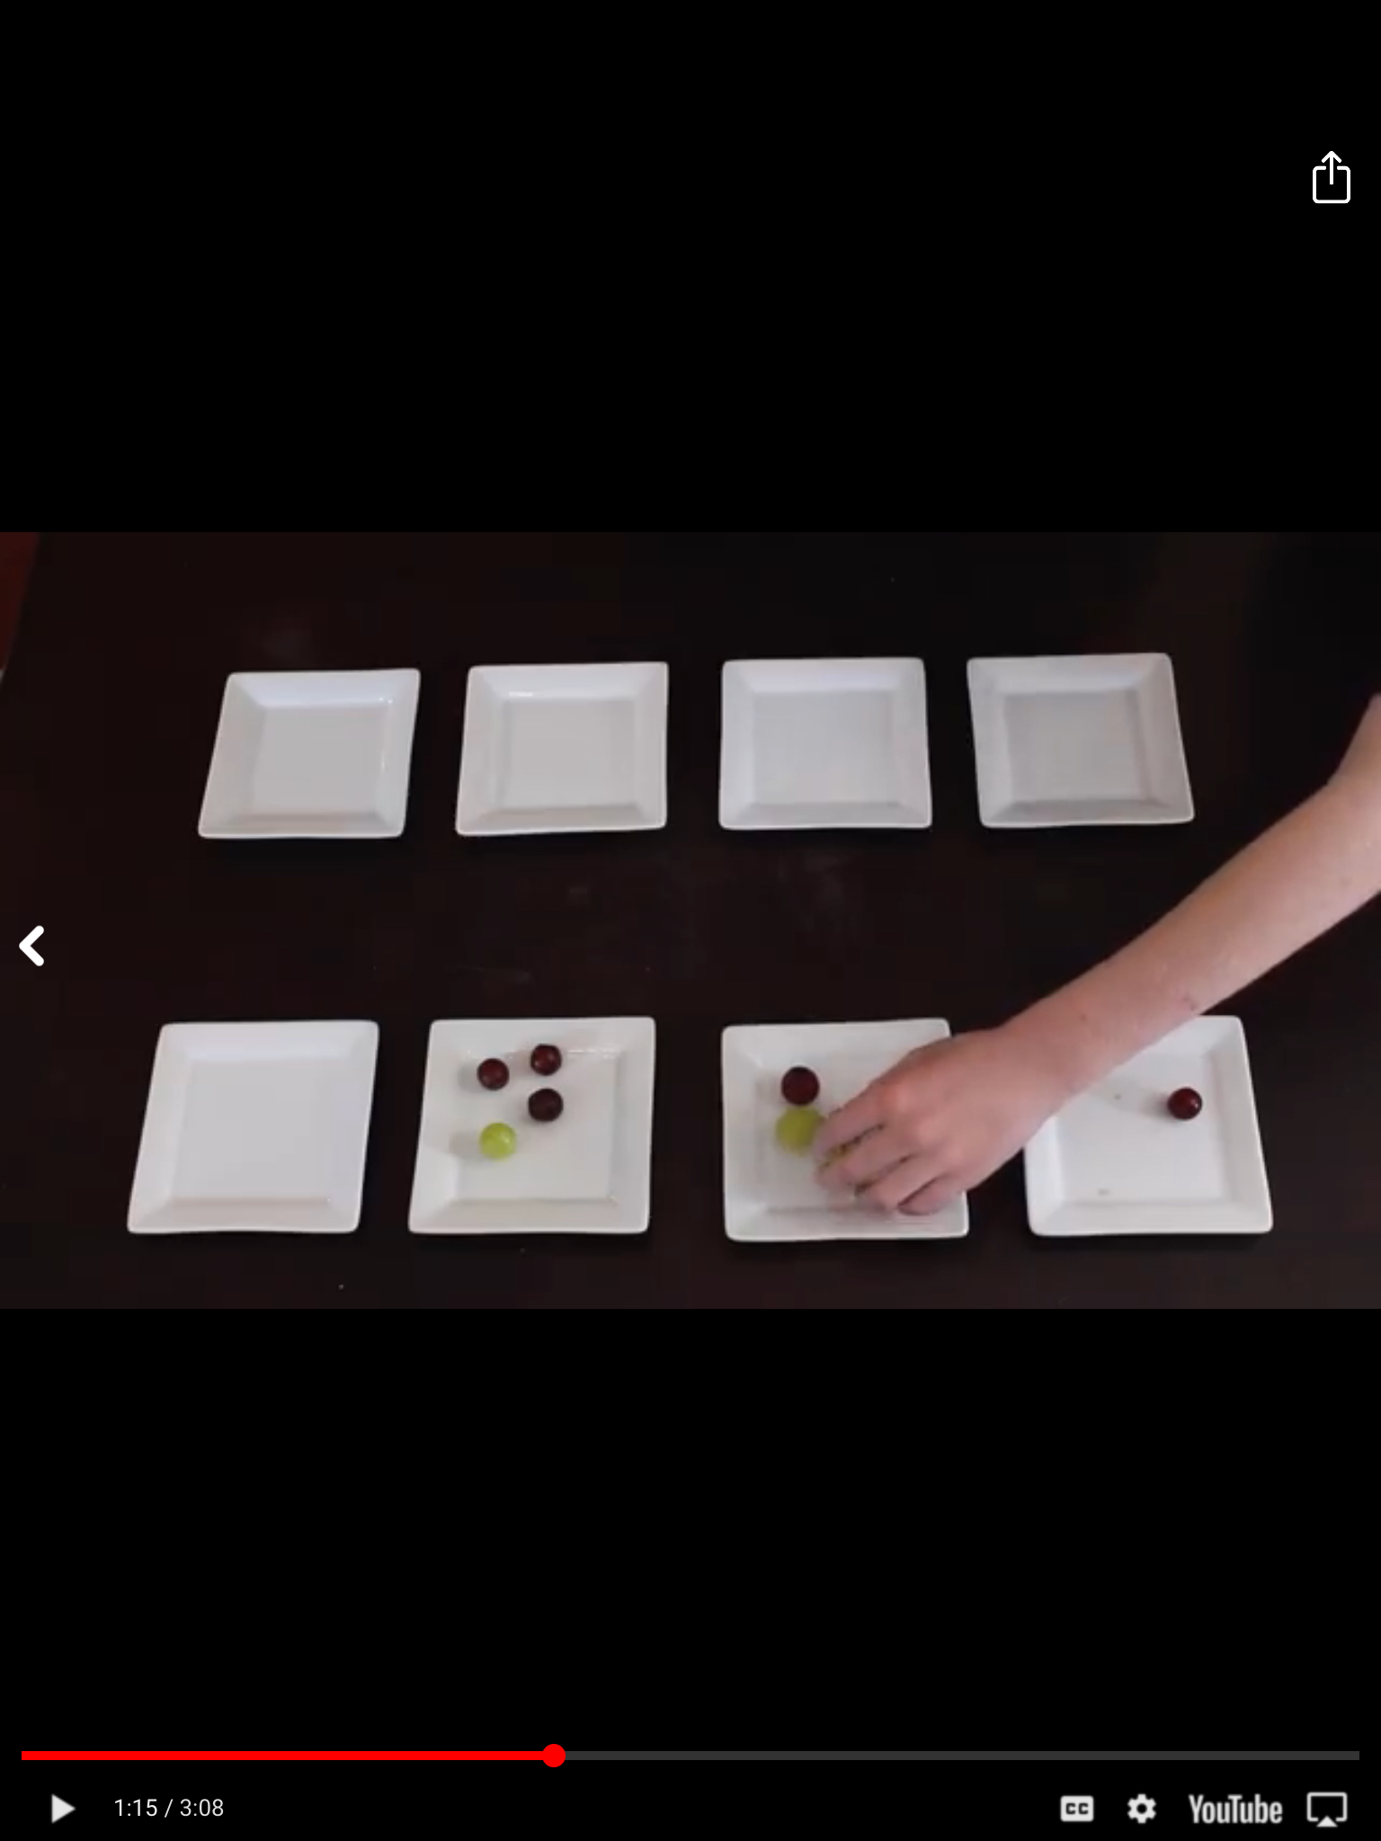
+
All content sharable

Slide 10
+
=
Thank You!
@EpsilonMarvi @OneOnEpsilon
www.epsilonstream.com

